Slide 1



Modern Linux Performance Tools for C++
Sasha Goldshtein
CTO, Sela Group
goldshtn
goldshtn

Slide 2
In This Talk
Mission: Use modern, lightweight, production-ready tools for performance monitoring and tracing C++ applications on Linux
Objectives:
Perform non-invasive CPU profiling by sampling
Trace system events, along with call stacks
Visualize call stacks using flame graphs
Use and extend performance scripts and tools in Python and Bash

Slide 3
CPU Sampling with perf

Slide 4
Sampling vs. Tracing
Sampling works by getting a snapshot or a call stack every N occurrences of an interesting event
For most events, implemented in the PMU using overflow counters and interrupts
Tracing works by getting a message or a call stack at every occurrence of an interesting event
CPU sample
pid 121
pid 121
pid 408
CPU time
pid 188
system time
pid 121
pid 408
disk write

Slide 5
Linux Sampling and Tracing Tools
Ease of use
dtrace for Linux
ply/BPF
SysDig
ktap
LTTng
perf
SystemTap
ftrace
bcc/BPF
C/BPF
new
stable
dead
custom .ko
Level of detail, features

Slide 6
perf
perf is a Linux multi-tool for performance investigations
Capable of both tracing and sampling
Developed in the kernel tree, must match running kernel’s version
Ubuntu: apt install linux-tools-common
Centos/FC: yum install perf

Slide 7
perf Data Sources (Events)
Hardware events: CPU cycles, LLC misses, branch mispredictions
Software events: page faults, CPU migrations
Tracepoints: syscalls, block I/O, network I/O, scheduler
Dynamic tracing: arbitrary kernel- or user-space functions
Timed CPU profiling can be performed by using a generic CPU clock cycles counter
Most virtualized environments won’t have hardware events (yet)

Slide 8
Some perf Scenarios (One-Liners)
Record CPU samples with stacks to find CPU hot path perf record -ag -F 97
Collect disk I/O access statistics and pinpoint heavy disk consumers perf record -e block:block_rq_insert -a
Probe user-space memory allocation failures with stacks perf probe -x /lib64/libc.so.6 --add 'malloc%return res=$retval' perf record -e probe:malloc --filter 'res==0' -g -p 188
Trace syscalls to find bad files, broken packets, abandoned children perf trace -e open
Monitor system performance (like top) on 1000s of metrics perf top perf top -e block:block_rq_insert perf top -e page-faults

Slide 9
Recording CPU Stacks With perf
To find a CPU bottleneck, record stacks at timed intervals:
# system-wide perf record -ag -F 97
# specific process perf record -p 188 -g -F 97
# specific workload perf record -g -F 97 -- ./myapp
Legend
-a all CPUs
-p specific process
-- run workload and capture it
-g capture call stacks
-F frequency of samples (Hz)
-c # of events in each sample

Slide 10
A Single Stack
# perf script parprimes 13393 248974.821897: 10309278 cpu-clock:
92b is_prime+0xffffffffff800035 (/…/parprimes)
96c primes_loop+0xffffffffff800021 (/…/parprimes)
9d4 primes_thread+0xffffffffff800020 (/…/parprimes)
75ca start_thread+0xffff011d4ae720ca (/…/libpthread-2.23.so)
…
# perf script | wc –l 7214

Slide 11
Stack Report
# perf report --stdio # Children Self Command Shared Object Symbol # ........ ........ ............ .................. ....................................... # 72.02% 71.53% parprimes parprimes [.] is_prime | --71.53%--start_thread primes_thread primes_loop is_prime
...truncated
27.86% 0.00% dd [kernel.kallsyms] [k] vfs_read | ---vfs_read | --27.80%--__vfs_read
...truncated

Slide 12
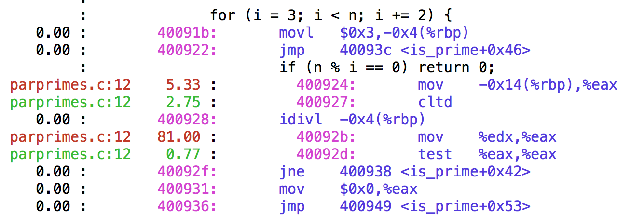
perf annotate
Occasionally, you’d need line-level information on where the samples happened in a specific function:
# perf annotate --stdio

Slide 13
Symbols
perf needs symbols to display function names (beyond modules and addresses)
For compiled languages (C, Go, …) these are often embedded in the binary
Or installed as separate debuginfo (usually /usr/lib/debug)
$ objdump -tT /usr/bin/bash | grep readline 0000000000306bf8 g DO .bss 0000000000000004 Base rl_readline_state 00000000000a46c0 g DF .text 00000000000001d4 Base readline_internal_char 00000000000a3cc0 g DF .text 0000000000000126 Base readline_internal_setup 0000000000078b80 g DF .text 0000000000000044 Base posix_readline_initialize 00000000000a4de0 g DF .text 0000000000000081 Base readline 00000000003062d0 g DO .bss 0000000000000004 Base bash_readline_initialized …

Slide 14
Report Without Symbols
# perf report --stdio # Children Self Command Shared Object Symbol # ........ ........ ....... ................. ....................... # 100.00% 0.00% hello hello [.] 0xffffffffffc0051d | ---0x51d | |--54.91%--0x4f7 | |--27.97%--0x4eb | |--8.73%--0x4e3 | --7.97%--0x4ff

Slide 15
Real-World Stack Reports
# perf report --stdio | wc -l 13823

Slide 16
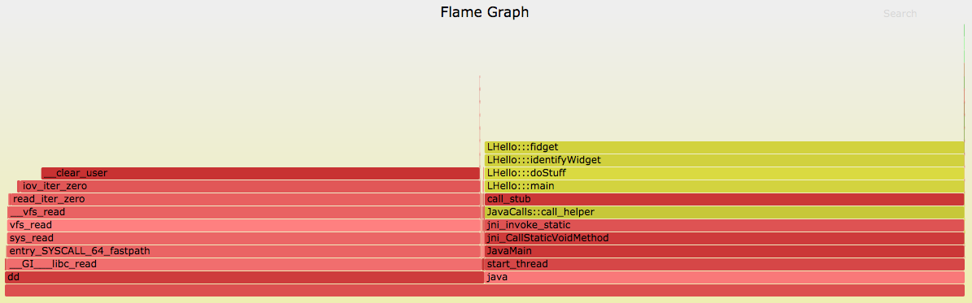
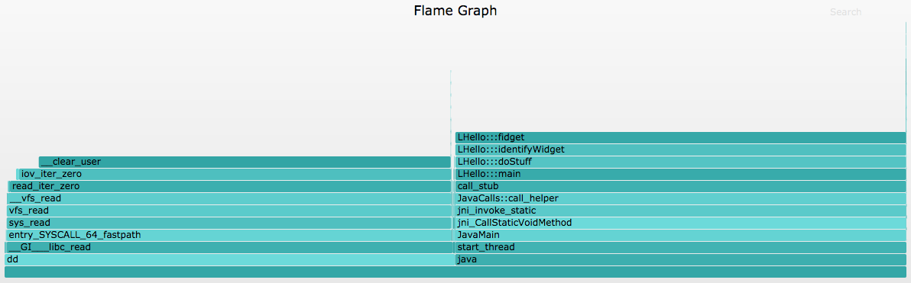
Flame Graphs
A visualization method (adjacency graph), very useful for stack traces, invented by Brendan Gregg
http://www.brendangregg.com/flamegraphs.html
Turns 1000s of stack trace pages into a single interactive graph
Example scenarios:
Identify CPU hotspots on the system/application
Show stacks that perform heavy disk accesses
Find threads that block for a long time and the stack where they do it

Slide 17
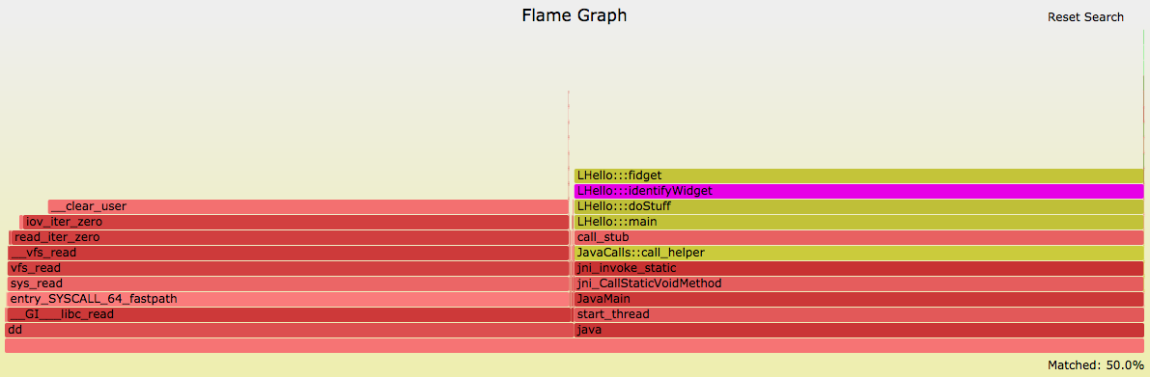
Reading a Flame Graph
Y-axis: stack depth
X-axis: sorted stacks (not time)
Each rectangle is a function
Wider frames are more common
Supports zoom, find
Filter with grep 😎

Slide 18
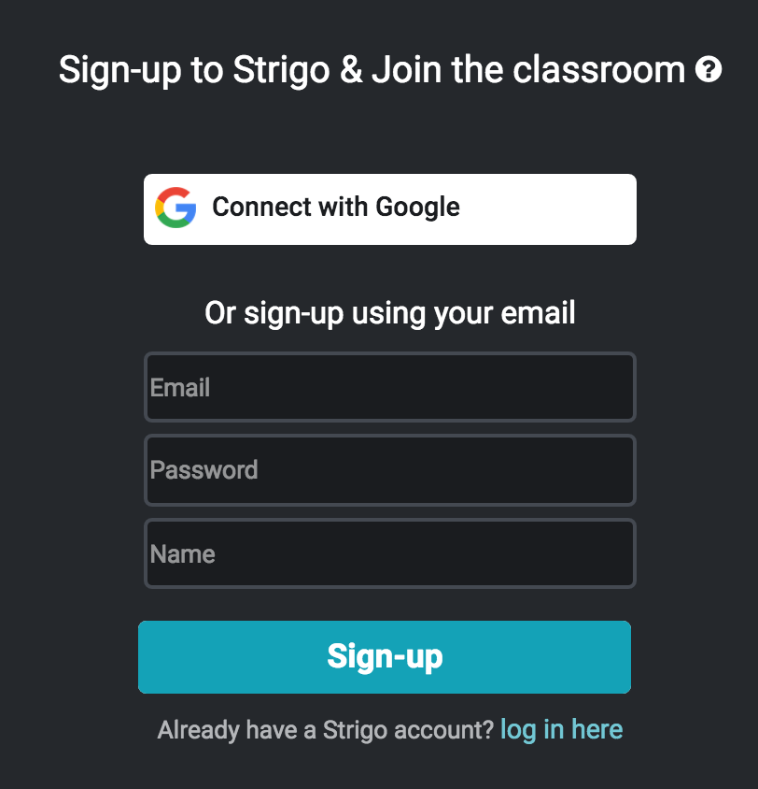

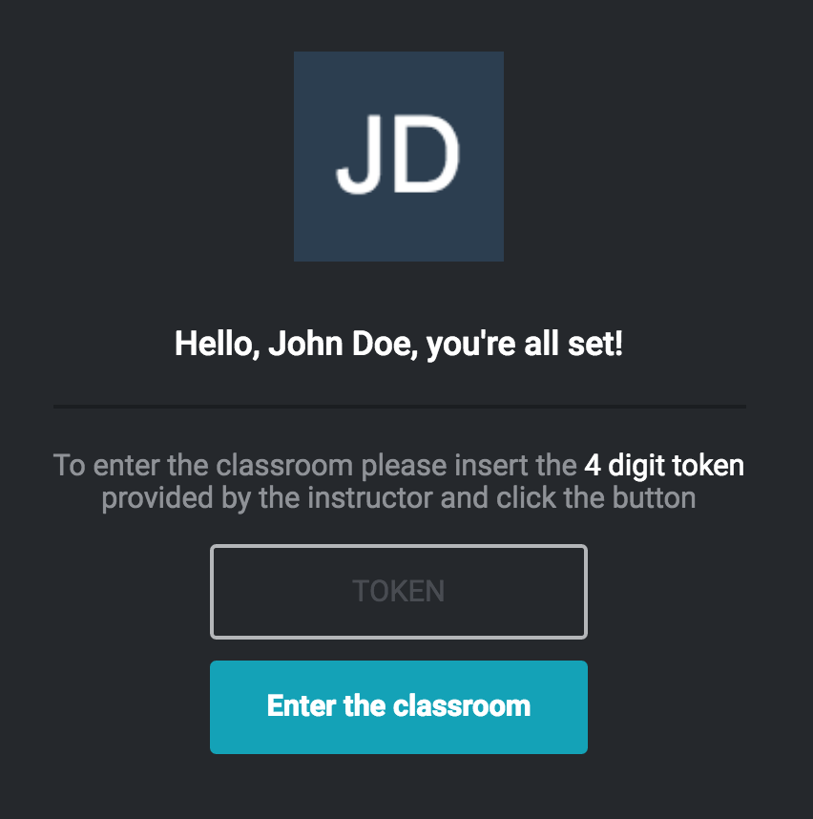
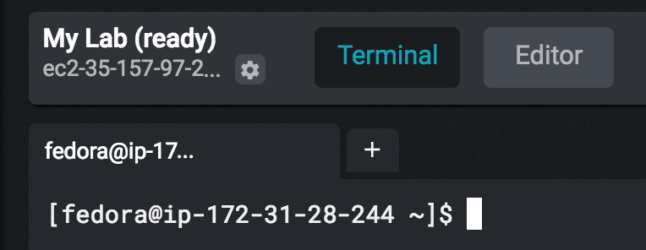
The Lab Environment
Follow the link provided by the instructor
Sign up or log in with Google
Enter the classroom token
Click the beaker-in-a-cloud icon to get your own lab instance
Wait for the terminal to initialize

Slide 19
Workshop landing page:
https://s.sashag.net/haifacpplabs
Exercise 1: CPU profiling with perf
and flame graphs

Slide 20
Kernel Tracepoints, Kprobes, And perf-tools

Slide 21
Kernel Tracepoints
Embedded in the kernel at compile-time to trace events from various areas in the system
1609 tracepoints in Linux 4.8
raw_syscalls: sys_enter
Applications
Syscall interface
xfs: xfs_buf_read
Filesystem
TCP
Scheduler
Mem
kmem: kmalloc
block: block_rq_insert
Block I/O
Networking
sched: sched_process_fork
Device drivers
irq: irq_handler_entry
net: net_dev_xmit

Slide 22
Recording Tracepoints With perf
# perf record -e sched:sched_process_exec -ag …
# perf report --stdio --sort comm,pid # Samples: 3 of event 'sched:sched_process_exec' # Event count (approx.): 3 # # Children Self Command Pid:Command # ........ ........ ....... ............... # 33.33% 33.33% cat 4326:cat | ---_start return_from_execve sys_execve do_execveat_common.isra.35 …

Slide 23
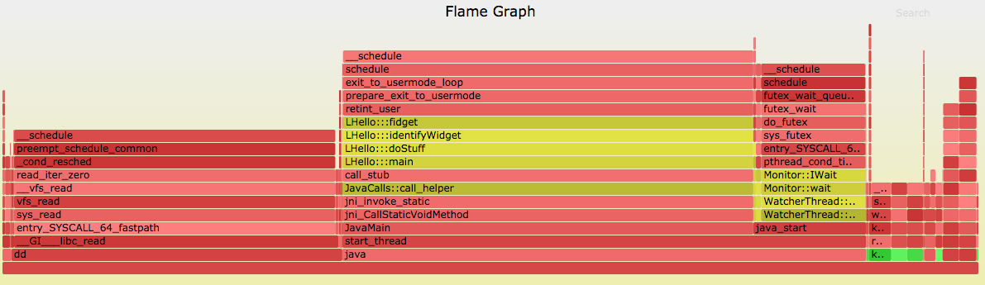
Context Switches Flame Graph
# perf record -e sched:sched_switch -ag -- sleep 5
# perf script | ./stackcollapse-perf.pl | ./flamegraph.pl --color=java

Slide 24
The perf-tools Tools
https://github.com/BrendanGregg/perf-tools
Collection of shell script front-ends to perf and ftrace
Examples:
opensnoop trace open() syscalls with filename and error
funcslower trace functions slower than a threshold
iolatency summarize I/O latency as a histogram
syscount count system calls

Slide 25
I/O Latency Histogram
# ./iolatency >=(ms) .. <(ms) : I/O |Distribution | 0 -> 1 : 0 | | 1 -> 2 : 0 | | 2 -> 4 : 17 |######################################| 4 -> 8 : 11 |######################### | …

Slide 26
Workload Characterization (Syscalls)
# ./syscount -c Tracing... Ctrl-C to end. ^C … open 130 fcntl 152
sched_yield 154
gettimeofday 158
rt_sigaction 187
rt_sigprocmask 195 close 219
mmap 225
mprotect 356
ioctl 634
futex 1751
clock_gettime 3249

Slide 27
Dynamic Tracing (Instrumentation)
Tracepoints can’t cover everything
Some areas don’t have tracepoints, e.g. TCP/UDP
Sometimes you really wish for another tracepoint
User space is not covered (although USDT is available, discussed later)
Dynamic tracing is about instrumenting arbitrary functions in kernel- or user-space
Count TCP segments sent/received
Trace failed memory allocations with allocation size
Trace creation of pthreads with the thread function
Aggregate database query text and latency

Slide 28
Kprobes And Uprobes
A kernel API for attaching a callback to an arbitrary* function
Kprobe/uprobe: attach to the function entry point
Kretprobe/uretprobe: attach to the function return
Can also attach to arbitrary locations within the function
Well, almost arbitrary: there is a small closed set of no-probe functions

Slide 29
Kprobes And Uprobes
libc:malloc
push %rbp push %rbx sub $0x8,%rsp …
libc:malloc
int $3 push %rbx sub $0x8,%rsp …
ftrace infrastructure
single step push %rbp
handler callback

Slide 30
Discovering Probe Locations
$ grep tcp_send /proc/kallsyms ffffffff81703410 t tcp_send_mss ffffffff81706680 T tcp_sendpage ffffffff81706cc0 T tcp_sendmsg …
$ objdump -tT /lib64/libpthread.so | grep mutex_lock 0000000000009990 g F .text 00000000000001ca pthread_mutex_lock 0000000000009990 g F .text 00000000000001ca __pthread_mutex_lock …
$ perf probe -x /usr/bin/bash -F read* read_builtin read_command read_history … readline

Slide 31
Placing Probes With perf
# perf probe -F *write* SyS_process_vm_writev
SyS_pwrite64
SyS_pwritev
SyS_write
…
# perf probe --add 'SyS_write +0(%si):string' Added new event:
probe:SyS_write (on SyS_write with text=+0(%si):string)
… # perf record -e 'probe:SyS_write' -p 2090 …
# perf script | head bash 2090 [000] 8672.045961: probe:SyS_write: (ffffffff81243390) text="[vagrant@fedora-24-x86-64 bin]$ sudo dnf clean packages"
…

Slide 32
Dynamic Instrumentation (MySQL)
# ./uprobe 'p:/usr/local/mysql/bin/mysqld: _Z11mysql_parseP3THDPcjP12Parser_state query=+0(%si):string' mysqld-3609 [001] d... 939.578057: _Z11mysql_parseP3THDPcjP12Parser_state: (0xf7dd2c0e70) query="call getproduct(93)"
mysqld-3609 [001] d... 939.578273: _Z11mysql_parseP3THDPcjP12Parser_state: (0xf7dd2c0e70) query="select * from users where id = 47"
mysqld-3609 [001] d... 939.578455: _Z11mysql_parseP3THDPcjP12Parser_state: (0xf7dd2c0e70) query="select id from products where userid = 47"
mysqld-3609 [001] d... 939.578670: _Z11mysql_parseP3THDPcjP12Parser_state: (0xf7dd2c0e70) query="call getproduct(94)" …

Slide 33
Dynamic Instrumentation (MySQL)
# ./funclatency -m '/usr/local/mysql/bin/mysqld: _Z11mysql_parseP3THDPcjP12Parser_state'
… ^C Function = mysql_parse(THD*, char*, unsigned int, Parser_state*) [3419] msecs : count distribution 0 -> 1 : 1692 |****************************************| 2 -> 3 : 0 | | 4 -> 7 : 0 | | 8 -> 15 : 0 | | 16 -> 31 : 0 | | 32 -> 63 : 0 | | 64 -> 127 : 0 | | 128 -> 255 : 0 | | 256 -> 511 : 0 | | 512 -> 1023 : 0 | | 1024 -> 2047 : 4 | |

Slide 34
eBPF and BCC

Slide 35
What’s Wrong With perf?
perf relies on pushing a lot of data to user space, through files, for analysis
Downloading a file at ∼1Gb/s produces ∼89K netif_receive_skb events/s (19MB/s including stacks)
kernel
user
monitor
e1000
netif_receive_skb
perf | awk | …
average packet size: 189 bytes
perf_events
perf.data

Slide 36
BPF: 1990
Invented by McCanne and Jacobson at Berkeley, 1990-1992: instruction set, representation, implementation of packet filters
$ tcpdump -d 'ip and dst 186.173.190.239' (000) ldh [12] (001) jeq #0x800 jt 2 jf 5 (002) ld [30] (003) jeq #0xbaadbeef jt 4 jf 5 (004) ret #262144 (005) ret #0

Slide 37
BPF: Today
Supports a wide spectrum of usages
Has a JIT for maximum efficiency
kernel
user
probes
BPF runtime
control program
verifier & JIT
sockets
control program
BPF program
syscalls
BPF program
BPF map
BPF compiler

Slide 38
BPF Tracing
kernel
user
①
kprobes
BPF runtime
control program
control program
②
tracepoints
BPF program
③
③
⑤
application
perf_events
map
USDT
②
④
uprobes
perf output
① installs BPF program and attaches to events
④ user-space program is invoked with data from the shared buffer
② events invoke the BPF program
③ BPF program updates a map or pushes a new event to a buffer shared with user-space
⑤ user-space program reads statistics from the map and clears it if necessary

Slide 39
BPF Tracing Features in The Linux Kernel
Version | Feature | Scenarios
4.1 | kprobes/uprobes attach | Dynamic tracing with BPF becomes possible
4.1 | bpf_trace_printk | BPF programs can print output to ftrace pipe
4.3 | perf_events output | Efficient tracing of large amounts of data for analysis in user-space
4.6 | Stack traces | Efficient aggregation of call stacks for profiling or tracing
4.7 | Tracepoints support | API stability for tracing programs
4.9 | perf_events attach | Low-overhead profiling and PMU sampling
24
16.04
25
16.10

Slide 40
The Old Way And The New Way
kernel
user
monitor
VFS
k{,ret}probe: vfs_read
perf | awk | …
LATμs # distribution 0 - 1 … |@@@@ | 1 – 2 … |@ | 2 - 4 … |@@@@@@@@ |
perf_events
perf.data
kernel
user
monitor
VFS
k{,ret}probe: vfs_read
control program
LATμs # distribution 0 - 1 … |@@@@ | 1 – 2 … |@ | 2 - 4 … |@@@@@@@@ |
BPF program
BPF map

Slide 41

The BCC BPF Front-End
https://github.com/iovisor/bcc
BPF Compiler Collection (BCC) is a BPF frontend library and a massive collection of performance tools
Contributors from Facebook, PLUMgrid, Netflix, Sela
Helps build BPF-based tools in high-level languages
Python, Lua, C++
user
BCC tool
BCC tool
…
BCC compiler frontend
Clang + LLVM
BCC loader library
kernel
BPF runtime
event sources

Slide 42
Observability With BCC Tools
perf-tools
BCC tools

Slide 43
BCC Linux Performance Checklist
execsnoop
opensnoop
ext4slower (or btrfs*, xfs*, zfs*)
biolatency
biosnoop
cachestat
tcpconnect
tcpaccept
tcptop
gethostlatency
cpudist
runqlat
profile

Slide 44
Some BCC Tools
# ext4slower 1 Tracing ext4 operations slower than 1 ms TIME COMM PID T BYTES OFF_KB LAT(ms) FILENAME 06:49:17 bash 3616 R 128 0 7.75 cksum 06:49:17 cksum 3616 R 39552 0 1.34 [ 06:49:17 cksum 3616 R 96 0 5.36 2to3-2.7 06:49:17 cksum 3616 R 96 0 14.94 2to3-3.4 ^C
# execsnoop PCOMM PID RET ARGS bash 15887 0 /usr/bin/man ls preconv 15894 0 /usr/bin/preconv -e UTF-8 man 15896 0 /usr/bin/tbl man 15897 0 /usr/bin/nroff -mandoc -rLL=169n -rLT=169n -Tutf8 ^C

Slide 45
BCC’s profile Tool
# profile 10 -F 97 -K # kernel stacks only … ffffffffa4818691 __lock_text_start ffffffffa45b0341 ata_scsi_queuecmd ffffffffa458813d scsi_dispatch_cmd ffffffffa458b021 scsi_request_fn ffffffffa43be643 __blk_run_queue ffffffffa43c3bc1 blk_queue_bio ffffffffa43c1cf2 generic_make_request ffffffffa43c1e4d submit_bio ffffffffa43b825d submit_bio_wait ffffffffa43c5c65 blkdev_issue_flush ffffffffa4309b4d ext4_sync_fs ffffffffa428b260 sync_fs_one_sb ffffffffa425a553 iterate_supers ffffffffa428b374 sys_sync ffffffffa4003c17 do_syscall_64 ffffffffa4818bab return_from_SYSCALL_64 - stress (3303) 14

Slide 46
BCC’s profile Tool
kernel
user
monitor
PMU cpu-clocks
perf script | fold | flamegraph
perf_events
perf.data
kernel
user
monitor
PMU cpu-clocks
profile –f | flamegraph
BPF map
BPF program
BPF stacks

Slide 47
Workshop landing page:
https://s.sashag.net/haifacpplabs
Exercise 2: Memory leak analysis with BCC tools

Slide 48
Wrap-Up

Slide 49
Summary
Mission: Use modern, lightweight, production-ready tools for performance monitoring and tracing C++ applications on Linux
Objectives:
Perform non-invasive CPU profiling by sampling
Trace system events, along with call stacks
Visualize call stacks using flame graphs
Use and extend performance scripts and tools in Python and Bash

Slide 50
References
Perf and flame graphs
https://perf.wiki.kernel.org/index.php/Main_Page
http://www.brendangregg.com/flamegraphs.html
BCC tutorials (by Brendan Gregg)
https://github.com/iovisor/bcc/blob/master/docs/tutorial.md
https://github.com/iovisor/bcc/blob/master/docs/tutorial_bcc_python_developer.md
https://github.com/iovisor/bcc/blob/master/docs/reference_guide.md
BPF
https://github.com/torvalds/linux/tree/master/samples/bpf
https://www.kernel.org/doc/Documentation/networking/filter.txt
https://github.com/iovisor/bpf-docs

Slide 51
Thank You!
✁
Slides: https://s.sashag.net/haifacpp17
Demos & labs: https://github.com/goldshtn/linux-tracing-workshop
Sasha Goldshtein
CTO, Sela Group
goldshtn
goldshtn

